Slide 2
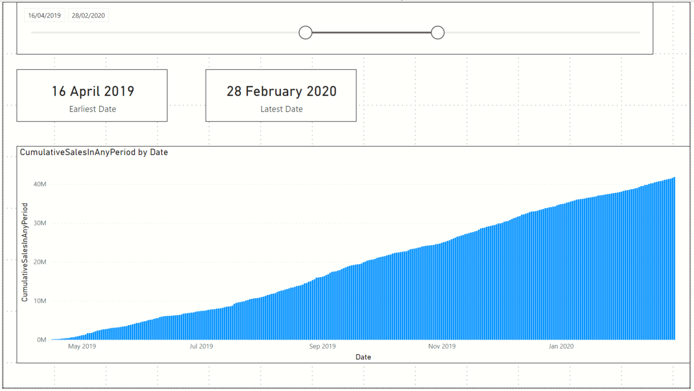
Card showing earliest
MyCalendar[Date]
Slicer on MyCalendar[Date]
Card showing latest
MyCalendar[Date]
Stacked Column Chart visual
X-axis = MyCalendar[Date]
Values = Custom measure CumulativeSalesInAnyPeriod

